Slide 1
To our class 3C
Teacher: Trần Thị Thúy

Slide 2
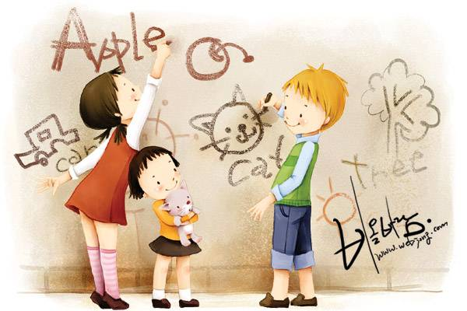
English 3
Let's play game
Slap the board

Slide 3
Thursday, March 2nd 2017. Unit 16: Do you have any pets?
Lesson 1: (1-3)
Activity 1: Look, listen and repeat
Activity 2: Point and say
Activity 3: Let’s talk

Slide 4
Thursday, March 2nd 2017. Unit 16: Do you have any pets?
Lesson 1: (1-3)
1. Look, listen and repeat

Slide 5
Thursday, March 2nd 2017. Unit 16: Do you have any pets?
Lesson 1: (1-3)
2. Point and say

Slide 6
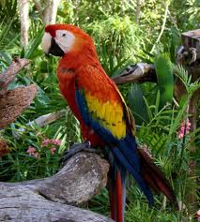
I. Vocabulary
- a cat: con mèo
- a parrot: con vẹt

Slide 7
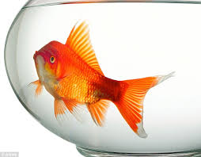
I. Vocabulary
- a cat: con mèo
- a parot: con vẹt
- a rabbit: con thỏ
- a goldfish: con cá vàng

Slide 8
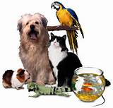
I. Vocabulary
- a cat: con mèo
- a parrot: con vẹt
- a rabbit: con thỏ
- a goldfish: con cá vàng
- pet: thú cưng, vật nuôi

Slide 9
I. Vocabulary
- a cat: con mèo
- a parrot: con vẹt
- a rabbit: con thỏ
- a goldfish: con cá vàng
- pet: thú cưng, vật nuôi

Slide 10
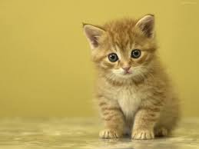
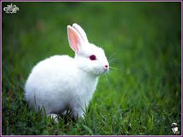
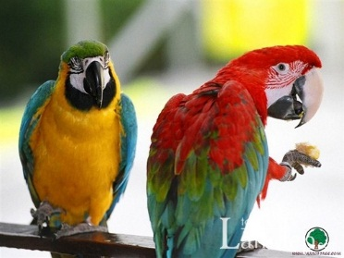
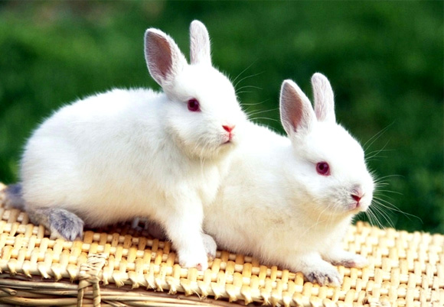
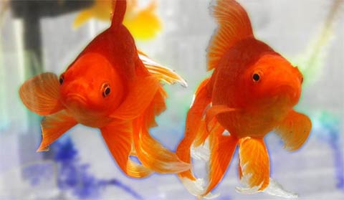
I. Vocabulary
a cat
a parrot
a rabbit
a goldfish
cats
parrots
rabbits
goldfish

Slide 11
I. Vocabulary
- a cat
- cats
- a parrot
- parrots
- a rabbit
- rabbits
- a goldfish
- goldfish
- pet
- pets

Slide 12
Thursday, March 2nd 2017
Check vocabulary:
Let’s play a game

Slide 13
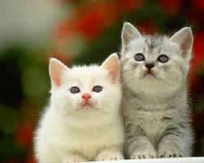
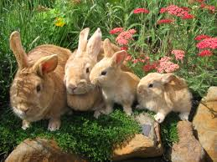
Let’s Match
A
C
1) rabbits
2) cats
3) goldfish
4) parrots
B
D

Slide 14
Let’s Match
A
C
1) rabbits
2) cats
3) goldfish
4) Parrots
B
D

Slide 15
Friday, December 5th, 2014
II.Pattern:
* Muốn hỏi bạn có thú cưng( vật nuôi) nào hay không?
- Do you have any + con vật?
Trả lời: + Yes, I do- vâng, mình có
+ No, I don’t- không, mình không có
e.g: - Do you have any dogs?
+ Yes, I do
+ No, I don’t

Slide 16
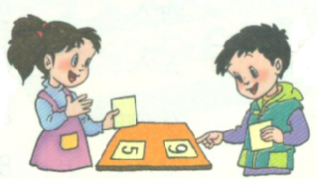

Slide 17
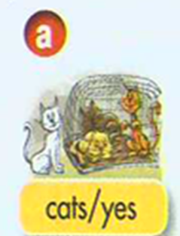
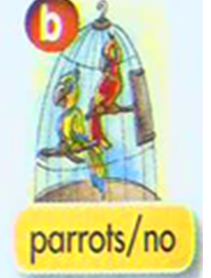
Do you have any cats? Yes, I do.
Do you have any parrots? No, I don’t.
Do you have any goldfish?
No, I don’t .
Do you have any rabbits? No, I don’t

Slide 18
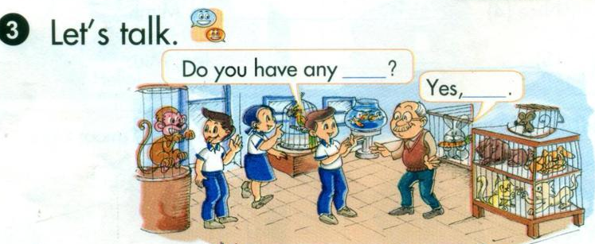
Thursday, March 2nd 2017
Unit 16: Do you have any pets?

Slide 19
Ring golden
What’s animal ?
Question1
rabbits
1
2
3
4
5
6
7
8
9
10

Slide 20
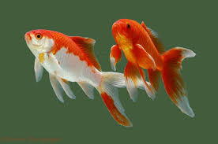
Ring golden
What’s animal?
Question2
goldfish
1
2
3
4
5
6
7
8
9
10

Slide 21
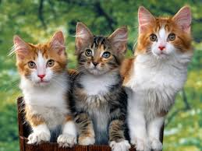
Ring golden bell
What’s animal?
Question 3
cats
1
2
3
4
5
6
7
8
9
10

Slide 22
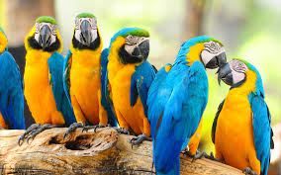
Ring golden
What’s animal?
Question 4
Parrots
1
2
3
4
5
6
7
8
9
10

Slide 23
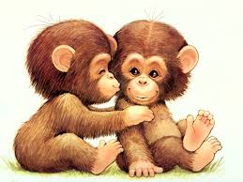
Ring golden
What’s animal?
Question 5
monkeys
1
2
3
4
5
6
7
8
9
10

Slide 24
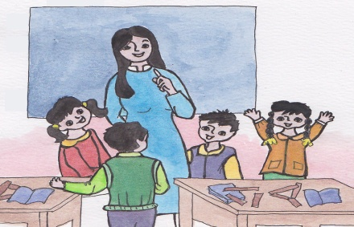
Thursday, March 2nd 2017
Unit 16:Do you have any pets?
Lesson 1: (1-3)
Vocabulary:
Sentence pattern:
dogs
cats
parrots
rabbits
goldfish
pets
Hỏi-đáp bạn có vật nuôi(thú cưng nào không?
- Do you have any + con vật? + Yes, I do.
+ No, I don’t.

Slide 25
Homework
- Prepare part 3, 4, 5 and 6 on page 41.
- Learn by vocabulary and practice sentence

Slide 26
GOODBYE
THANK YOU FOR
YOUR ATTENTION

